Slide 1
Confidential Report:
Robert Soderbery
October 2023

Slide 2
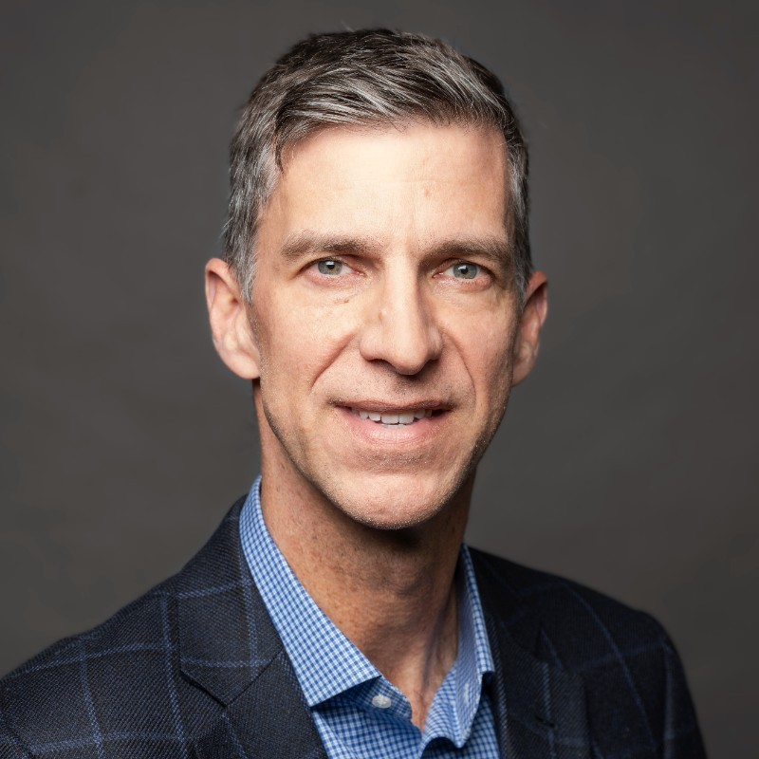
Profile: Robert Soderbery
rsoderbery@gmail.com / rob@soderbery.com
+1 650 387 3609 (Mobile)
Location: Palo Alto, CA
Education
MS, Electrical Engineering, Computer Science Engineering and Software Focus, Stanford University
1987 BS, Electrical Engineering, California Institute of Technology
Experience
2020 – present Western Digital Corporation
EVP & General Manager, Flash Business Unit
2017 – 2020 UPLIFT
2018 – 2020 President, Co-Founder
2017 – 2018 Chief Operating Officer, Co-Founder
2009 – 2016 CISCO SYSTEMS
2014 – 2016 Senior Vice President, Enterprise Products and Solutions
2013 – 2014 SVP and General Manager, Enterprise Products and Solutions
2009 – 2013 SVP & General Manager, Ethernet Switching Technology Group
2004 – 2009 Symantec
2008 – 2009 SVP, Storage & Availability Management Group
2006 – 2008 SVP, Storage Foundation Group
2005 – 2006 Vice President, Product Management, Data Center Management Group
2000 – 2005 Veritas Software (acquired by Symantec in 2005)
2004 – 2005 Vice President, Product Management
2002 – 2004 Vice President, Strategic Alliances
2001 – 2002 Senior Director, Strategic Alliances
2000 – 2001 Senior Director, Product Management
1999 – 2000 ADAPTEC
Senior Director, Strategic Marketing
1994 – 1999 ARITHMOS
Vice President, Product Marketing & Co-Founder
1989 – 1993 C-CUBE MICROSYSTEMS
1991 – 1993 Director, Product Management
1989 – 1991 Manager, Systems Engineering
1987 – 1989 TRW
ASIC Design Engineer, ESL
WHY ARE WE PRESENTING THIS CANDIDATE
Rob Soderbery is a proven general manager at scale in the enterprise infrastructure sector, with experience across semiconductor, systems and software. While he has not been a public company CEO, we believe he brings the key attributes for the role.
He leads a $8B+ P&L today at WD (team of 5000+ of which about 1000 are ASIC engineers) and has led larger businesses at Cisco ($20B P&L and team of 8000+).
He led complex businesses with various GTM motions, especially at Cisco. He brings direct experience with sales force optimization, routes to market mix, compensation and incentives alignment etc. He has also directly engaged in the sales process for hyperscalers (a $1B+ business today for WD).
While comfortable at scale, Rob is also entrepreneurial and can “get his hands dirty”. He was the co-founder of Uplift which he led as COO and later President for almost four years. Earlier in his career, he c0-founded Arithmos, an analog firm focused on LCD transitions, which was later acquired by ST Micro.
Financially, Rob is a seasoned operator and a well-rounded executive.
In addition to managing the P&L of his Flash business at WD, he is deeply engaged in the earnings management process and regularly engages with all the key analysts covering the industry and the stock. He runs a capital-intensive business at WD (owns a fab) and has developed a strong understanding of the balance sheet and its levers of impact.
As a Board member at Rockwell Automation ($7B revenue, $30B+ market cap), Rob serves on the Audit Committee, thereby enhancing his capability on related governance, risk and compliance issues.
Lastly, WD has an activist (Elliot) and a PE firm (Apollo) engaged in the company that has forced Rob to build a playbook for engaging with these alternate investors.

Slide 3
Profile: Robert Soderbery
FIT AND LEADERSHIP STYLE
Rob focuses on developing followership, with a sense of accountability. He believes in creating the vision and strategy and then translating that into execution priorities at all the levels of the organization. He is operationally and execution oriented with a bias for action - aligned goals and deliverables, accountability.
Rob builds strong teams that complement him and have the same sense of accountability. He has a strong belief in an open, connected style of leadership that relies on guided collaboration, which involve a mix of driving to a strategic outcome, while providing room for buy-in and autonomy from the organization.
His own time is spent 60% on strategy and execution-oriented problem solving, and the remaining 40% on bringing the team along and getting buy in.
He adheres to a 10 x 10 framework – “what are the 10 big things that have to be done for the organization to be successful AND what the are the 10 big things that I have to do personally to drive that success”.
INTEREST LEVEL
Rob is interested in the role. After having been a member of the senior leadership teams at both Cisco and WD, he is keen to be a CEO and lead a company. As the future of WD remains quite volatile, and the company’s go-forward strategy is being actively reconsidered, he is quite ready to do something different.
Rob is energized by transformations and his initial understanding of the SGH story makes him quite interested to learn more. He is doing his research on the company and trying to better understand the opportunity for the company’s future success, although he agrees that the market timing and positioning feel right. He also knows and has deep respect for Mark Papermaster, and sees his involvement as a strong positive.
AREAS TO PROBE
While Rob brings semiconductor, systems and software experience he is certainly not an expert in computing or its place in the AI landscape. Since the industry would be new to him, does he bring the right building blocks to quickly come up to speed in this area?
It will be a step up for Rob as a first-time CEO, let alone a public company CEO. Given the skillset he brings, where will he find himself most challenged and what possible steps could be taken to mitigate those hurdles if he’s selected?
HELPFUL LINKS
LinkedIn profile: https://www.linkedin.com/in/robertsoderbery//
WD Flash Perspective: A Conversation with Rob Soderbery; May 26, 2021 (Video, 5:27) https://www.youtube.com/watch?v=JfsLnx3xh4s
Western Digital Hires Industry Veteran Robert Soderbery; Sept 22, 2020 (Press release) https://www.westerndigital.com/company/newsroom/press-releases/2020/2020-09-22-western-digital-hires-industry-veteran-robert-soderbery
Rockwell Automation Elects Robert Soderbery to Board of Directors; Feb 03, 2022 https://www.businesswire.com/news/home/20220203005785/en/Rockwell-Automation-Elects-Robert-Soderbery-to-Board-of-Directors
WD 2021 Flash Summit Recap; Oct 2021 (Video post, 1:58) https://www.linkedin.com/posts/western-digital_2021-flash-summit-recap-activity-6808070148117823488-H-UJ?utm_source=share&utm_medium=member_desktop

